Slide 1
Analytics Project Presentation - Fall 2014
Analytics Project: Will You Watch What You Read?
Team: Anto Loyola, Nikita Keswaney, Rachita Hajela
Abstract: The project attempts at finding out how well a movie will do if it has been adapted from a book of a particular genre i.e. what kind of works should movie makers adapt? Will a movie based on a romantic novel will do better than one based on science fiction novel? Or movies based on series of books like Lord of the rings are the best way to top the blockbuster charts? The project also aims at finding the anomalies where the book did exceptionally well but the movie did not and vice versa based on the IMDB ratings for the movies and GoodReads rating for the books.

Slide 2
Will You Watch What You Read?
Background
This project takes into account how well or not well the movies did which were not original ideas but were an adaptation of a novel/play/book. We are trying to find out if there is a particular genre that might be the formula for the instant hit.
Motivation
Watching movies and reading books are the favorite pass times of the today’s world. What happens when both of these are combined ? There must be a reason why movies adapted from novels are doing exceptionally well. Five of the top ten films on the American Film Institute’s list of the 100 best movies of the last 100 years are adaptations of novels. Indeed we like to watch what we read but this is not true always. There have been many instances where the bubble of hype has been severely burst by the fans of the book and the movie has been criticized a lot.
This analytic aims to find out if a movie will do better if it has been adapted from a book of a particular genre by analyzing the past trends. So that the risk of the movie makers is lowered and they know what kind of works should be adapted. This project also finds the anomaly in the data so as to help movie makers understand what went wrong.

Slide 3
Will You Watch What You Read?
Data Sources
1. Books
This data source provides us with book name and its genre along with some other information
2. Adaptation
'Adaptation' is a general data source that provides us with any work that was adapted from another work (usually, but not necessarily, in a different artistic medium). Most of the works are adapted from the books and made into films.
3. Adapted Works
This data source provides us with works that have been adapted into various forms, or 1 work that has been adapted many times for example William shakespear’s taming of the shrew has been adapted into 5 different movies.

Slide 4
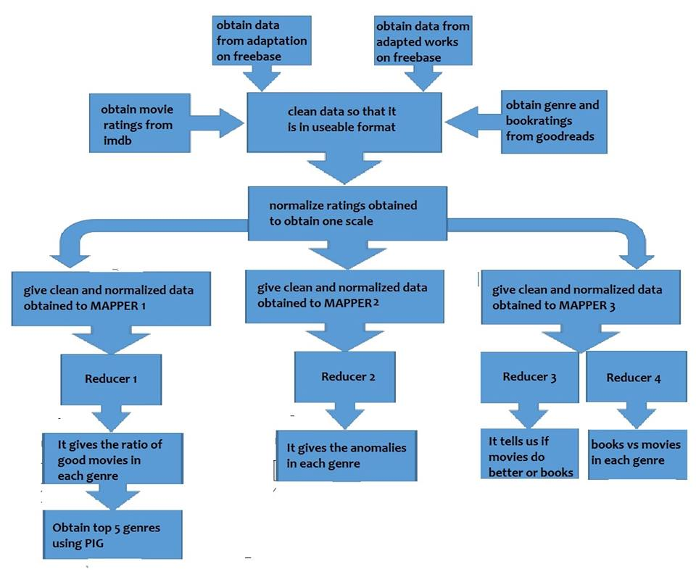
Will You Watch What You Read?
Design Diagram

Slide 5
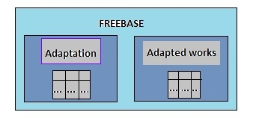
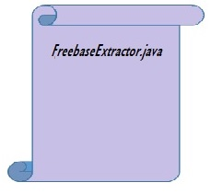
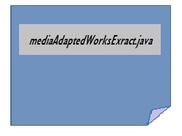
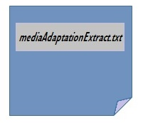

Slide 6
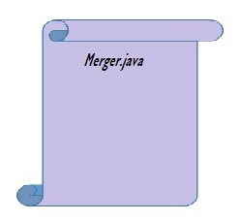
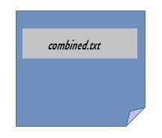
Combiner.java

Slide 7
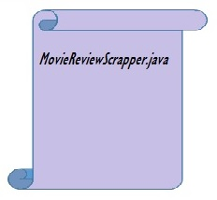

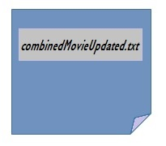
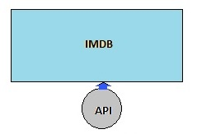
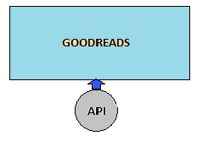
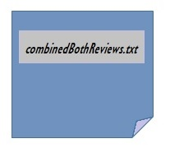
✔

Slide 8
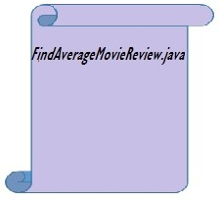
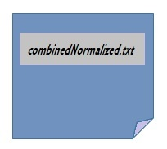
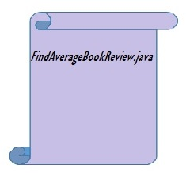

Slide 9
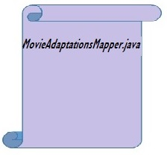
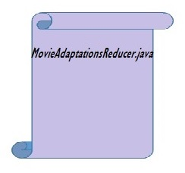
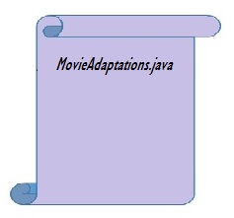
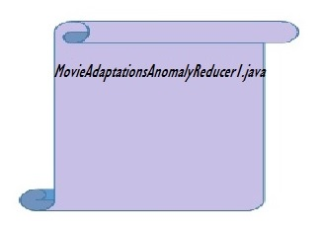
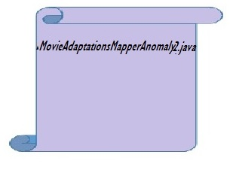
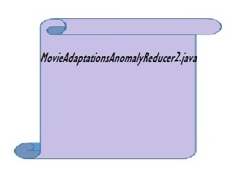
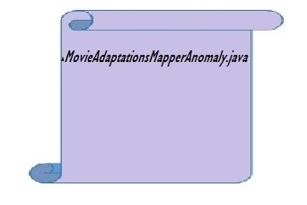
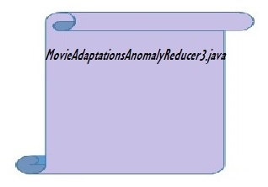
Best Movie Genres
(using PIG)
✔
Top 5 Anomalies (Genre)
(using PIG)
✔
Books vs. Movies
✔
Books vs. Movies ( per Genre )
✔

Slide 10
Will You Watch What You Read?
Results
1. Which Genres work the best?

Slide 11




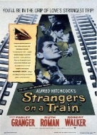

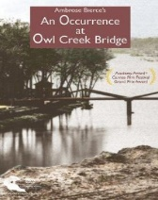
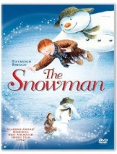
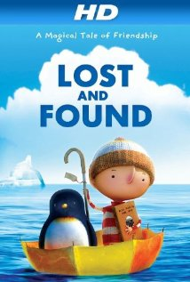

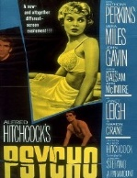
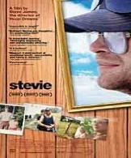
Will You Watch What You Read?
The genre categories which work with their success percentage are :
Genre | Success Percentage | Number of Movies
Film-Noir | 100.0 | 28
Adult | 100.0 | 5
Short | 99.52 | 2049
Horror | 97.85 | 2097
Documentary | 97.14 | 35

Slide 12
Will You Watch What You Read?
The Genre categories which have least success rates :
Genres | Percentage | Number of Movies
Thriller | 68.79 | 205
Western | 71.70 | 53
Sport | 75.0 | 16
Musical | 76.79 | 56

Slide 13
Will You Watch What You Read?
2. Genres with Maximum Anomalies (Higher Risk Zone)
Anomaly : When the book had a good rating but the movie didn’t do well or vice versa.
Genre | Number of Movies with Anomalies
Drama | 123
Horror | 118
Short | 102
Comedy | 64
Romance | 35

Slide 14
Will You Watch What You Read?
3. In case of an anomaly what did better ? Movie or the Book ?
Book in 460 cases
Movie in 228 cases

Slide 15
Will You Watch What You Read?
For each category of Genre , if there is an anomaly , are books doing well or the Movies?
Except for these 4 categories, in every category Books had higher success rate than the movies.
Genre
Animation
Horror
Short
Film-Noir

Slide 16
Will You Watch What You Read?
Obstacles
1. Fetching data from Freebase.
The freebase APIs are rigid. They don’t support specific data extraction methods. The documentation is also inadequate.
2. Data in freebase is populated by public so it contains a lot of junk data as well which was difficult to clean
3. IMDB and GoodReads has restriction on number on http requests one can process per unit time which led to slower extraction of data.
4. The rating scales for IMDB and GoodReads were different. Normalization of the ratings to reach logical results was time consuming and difficult.

Slide 17
Will You Watch What You Read?
Conclusion
We have successfully found the top genre categories for which movie adaptations work well. We have found that even though certain genres like horror, short have done well, they still occur in the top genres with anomalies. So they belong to the risk zone. Top safe genres are categories like film-noir and adult movies which both have 100% success rates and all movies from these genres have ratings above 7. The analytic provides movie makers enough information to capture the mood of the public.
Acknowledgements
We would like to thank our Professor Suzanne McIntosh for her immense support in developing the project and helping us out with the various technologies that could be used in the project.
We would like to thank freebase.com which provided us with the free data source.
We are thankful to all the readers and movie watchers who made the effort to rate the books and movies on Goodreads and Imdb.

Slide 18
Will You Watch What You Read?
References
Chan Ik (Park Chungwoon University ), Ho Eun ( Lee Chungwoon University), An Investigation into the Factors Determining the Success of Comic Book-Based Movies, http://www.aicit.org/AISS/ppl/AISS3692PPL.pdf
Ashley Ross, How to turn a book into a movie that isn’t terrible, http://time.com/2815729/book-to-movie-adaptations-screenwriters
Dwight C. Douglas How to adapt a novel into a screenplay, http://www.videomaker.com/article/15701-how-to-adapt-a-novel-into-a-screenplay
Michael Hauge, ADAPTATION: Movies aren’t novels, http://www.storymastery.com/articles-by-industry/articles-for-screenwriters/movies-arent-novels/
Lynne Pembroke and Jim Kalergis, From Novel to Screenplay: The Challenges of Adaptation, http://www.writing-world.com/screen/adaptation.shtml
Adaptation from novel to film, http://d2buyft38glmwk.cloudfront.net/media/cms_page_media/11/FITC_Adaptation_1.pdf
Hadoop – a definitive guide by Tom White

Slide 19
Will You Watch What You Read?
Github link :
https://github.com/antoloyola90/WillYouWatchWhatYouRead
https://github.com/antoloyola90/WillYouWatchWhatYouReadMapperReducer
Thank you!

